Slide 1
IBM University Engagement Project Submission
“Exploring the Power of Agentic AI with IBM Granite and LangFlow”

Slide 2

Project Tile – Recipe Preparation Agent
Domain of Project – Food & Nutrition
Student Name | Recent Passport Photo | Email ID | Mobile number [WhatsApp]
BHARGAVI BHONAGIRI |  | bhargavibhonagiri5@gmail.com | 92472 48626

Slide 3
Problem Statement -
Problem Statement: Recipe Preparation Agent
The Challenge
Many individuals face difficulty in deciding what meals to prepare using the ingredients available in their kitchen. Searching for recipes across multiple sources is often time-consuming and may require additional ingredients that are not readily available. This can lead to food waste, increased expenses, and inefficient meal planning. Users need a smart solution that can utilize available ingredients effectively and provide practical cooking guidance.
The Objective • Develop an AI-powered Recipe Preparation Agent that generates recipes using available ingredients provided by the user.
• Provide personalized recipe suggestions based on ingredient availability and cooking requirements.
• Generate clear step-by-step cooking instructions for easy meal preparation.
• Recommend suitable ingredient substitutions when certain ingredients are unavailable.
• Offer cooking tips and dietary recommendations based on user preferences or restrictions.
• Reduce food waste by maximizing the use of available groceries and pantry items.
• Save time and simplify meal planning through intelligent recipe recommendations.
• Utilize IBM watsonx.ai, Langflow, and Generative AI technologies to create a smart and user-friendly cooking assistant.

Slide 4
Technology Used
Tech Stack
I used
• Langflow + IBM watsonx.ai + Meta Llama 3.3 70B Instruct
• IBM Cloud Lite + Generative AI
• Prompt Engineering + Natural Language Processing (NLP)

Slide 5
Proposed Solution -
Proposed Solution: Recipe Preparation Agent
• Develop an AI-powered Recipe Preparation Agent that enables users to generate recipes using the ingredients available in their kitchen.
• Allow users to enter available ingredients through a simple and interactive Langflow-based interface.
• Utilize IBM watsonx.ai and the Meta Llama 3.3 70B Instruct model to analyze user inputs and generate personalized recipe recommendations.
• Generate complete recipe details, including recipe name, preparation time, ingredients used, and step-by-step cooking instructions.
• Provide intelligent ingredient substitution suggestions when certain ingredients are unavailable.
• Offer cooking tips and dietary recommendations to improve the overall cooking experience.
• Help users reduce food waste by maximizing the utilization of available groceries and pantry items.
• Deliver a fast, user-friendly, and efficient cooking assistant that simplifies meal planning and preparation using Generative AI technologies.

Slide 6
Langflow component Used -
1) Chat Input – Interface where users enter available ingredients to generate personalized recipe recommendations.
2) IBM watsonx AI Agent – Processes user-provided ingredients using a Large Language Model and generates recipes, cooking instructions, ingredient substitutions, and dietary suggestions.
3) Name of IBM Foundation Model – Meta Llama 3.3 70B Instruct → Used for intelligent recipe generation, cooking guidance, and personalized meal recommendations.
4) Chat Output – Displays AI-generated recipe details, including recipe name, preparation time, ingredients used, step-by-step cooking instructions, substitutions, and cooking tips.
5) File Component – Not used in the current implementation. (Can be used in future enhancements for recipe datasets and RAG-based knowledge retrieval.)
6) Prompt Template – Converts user ingredient inputs into structured prompts that guide the AI model to generate detailed and accurate recipe recommendations.

Slide 7
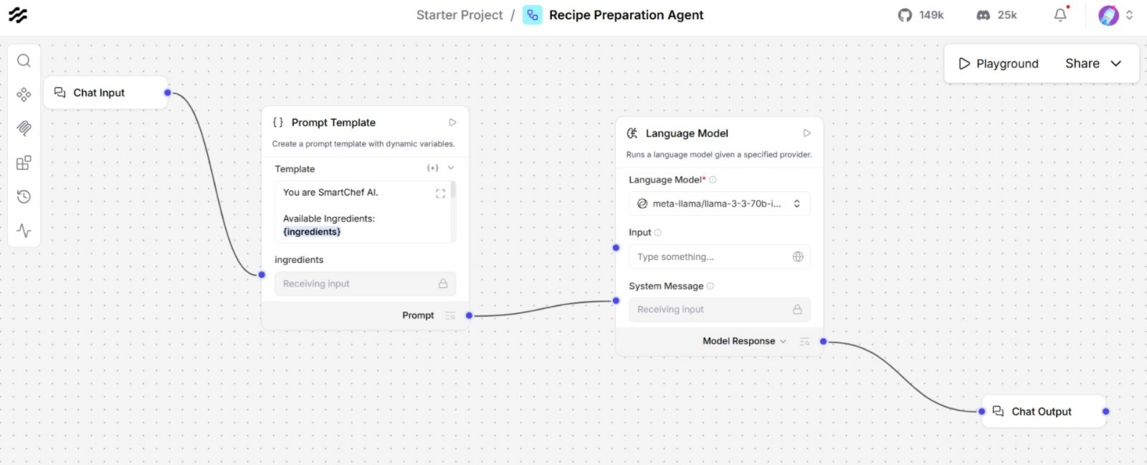
Langflow workflow -

Slide 8
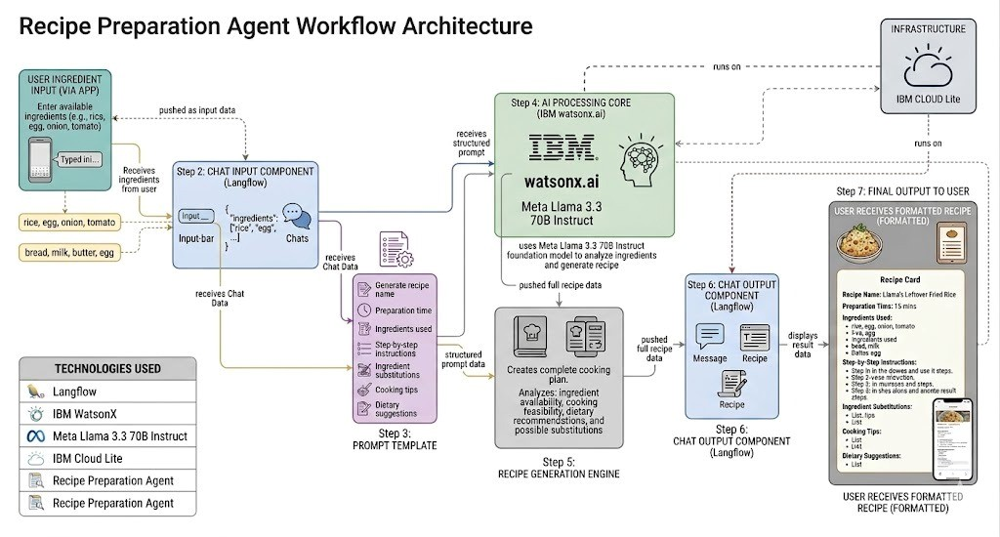
Architecture blueprint

Slide 9

Role of Agentic AI in the solution
Role of Recipe Preparation Agent
The Recipe Preparation Agent is powered by Generative AI using IBM watsonx.ai and Meta Llama 3.3 70B Instruct model. The AI acts as a single intelligent agent that autonomously understands user-provided ingredients and generates personalized recipe recommendations.
The agent handles the complete cooking assistance task — analyzing ingredients, generating recipes, providing step-by-step instructions, suggesting substitutions, and offering dietary tips — all through intelligent prompt engineering.
As a future enhancement, a full multi-agent system can be implemented with specialized agents for recipe retrieval, ingredient substitution, and nutritional guidance.

Slide 10
Technology Used
Langflow – For designing and building the Recipe Preparation Agent workflow visually. Used to connect Chat Input, Prompt Template, IBM watsonx.ai, and Chat Output components in a no-code/low-code environment.
IBM watsonx.ai – Core AI platform used for model deployment and recipe generation. Processes structured prompts and communicates with the foundation model to deliver intelligent responses.
Meta Llama 3.3 70B Instruct – Large Language Model (LLM) used for natural language understanding and recipe generation. Analyzes user-provided ingredients and generates personalized recipes, substitutions, cooking instructions, and dietary suggestions.
IBM Cloud Lite – Provides the cloud infrastructure to access IBM watsonx.ai services securely. Enables reliable and scalable deployment of the Recipe Preparation Agent.
Prompt Engineering – Used to structure user ingredient inputs into detailed prompts that guide the AI model to generate accurate and complete recipe recommendations.
Generative AI – The core technology powering the agent to autonomously generate context-aware, personalized recipe content based on available ingredients.

Slide 11
Novelty and Uniqueness
The Recipe Preparation Agent stands out by combining Generative AI, Prompt Engineering, and intelligent cooking assistance into a single, user-friendly system.
Ingredient-First Approach – Unlike traditional recipe apps that require users to search by dish name, this agent works in reverse — users provide available ingredients and the AI generates suitable recipes automatically.
Zero Food Waste Focus – Uniquely designed to maximize utilization of existing pantry items, helping users cook practical meals without buying extra groceries.
All-in-One Cooking Assistant – Goes beyond simple recipe suggestions by providing step-by-step cooking instructions, ingredient substitutions, cooking tips, and dietary adjustments in a single response.
Intelligent Substitution Engine – Automatically suggests alternative ingredients when certain items are unavailable, making recipes flexible and practical.
Prompt Engineering Driven – Uses carefully structured prompts to guide the AI model to generate complete, accurate, and personalized recipe content every time.
Built on Enterprise-Grade AI – Powered by IBM watsonx.ai and Meta Llama 3.3 70B Instruct, ensuring reliable, scalable, and high-quality recipe generation.
Accessible to Everyone – Simple ingredient input interface makes it usable by beginners and experienced cooks alike, requiring no technical knowledge.
This makes the solution a smart, practical, and sustainable digital chef — not just a static recipe search tool.

Slide 12
Git Hub Link
Github URL – https://github.com/bhargavi-22-b/Recipe-Preparation-Agent

Slide 13
Future Scope
1. RAG-Based Recipe Knowledge Retrieval –
Integrate a recipe knowledge base using Retrieval-Augmented Generation (RAG) so the agent can fetch real recipes from a database instead of generating from scratch. This will improve accuracy and provide more reliable, tested recipes to users.
2. Multi-Agent System Implementation –
Expand the current single-agent system into multiple specialized agents — a Recipe Knowledge Agent, Ingredient Substitution Agent, and Cooking Guidance Agent — working collaboratively to deliver more accurate and comprehensive cooking assistance.
·

Slide 14


